Slide 1
MODULE 1
Machine language - Instructions, addressing modes, Stored program concept.
Evolution of the RISC Architecture.

Slide 2
MACHINE LANGUAGE
A program written in assembly language is translated from mnemonics to a representation using only 1’s and 0’s, called machine language.
RISC-V uses 32-bit instructions.
Again, regularity supports simplicity, and the most regular choice is to encode all instructions as words that can be stored in memory

Slide 3
Design Principle 4:
Good design demands good compromises.

Slide 4
Instructions
RISC-V makes the compromise of defining four main instruction formats: R-type, I-type, S/B-type, and U/J-type.
R-type (register) instructions, such as add s0, s1, s2, operate on three registers
I-type (immediate) instructions, such as addi s3, s4, 42, and
S/B-type (store/branch) instructions, such as sw a0, 4(sp) or
beq a0,a1,L1, operate on two registers and a 12- or 13-bit signed immediate.
U/J-type (upper immediate/jump) instructions, such as jal ra, factorial, operate on one register and a 20- or 21-bit immediate.

Slide 5
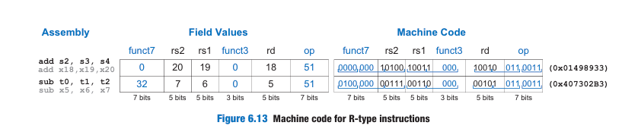
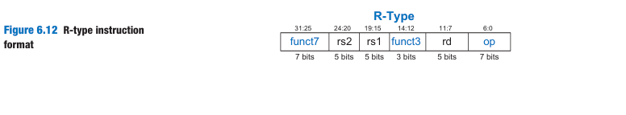
R-Type Instructions
R-type (register-type) instructions use three registers as operands: two as sources and one as a destination.
The 32-bit instruction has six fields: funct7, rs2, rs1, funct3, rd, and op.

Slide 6
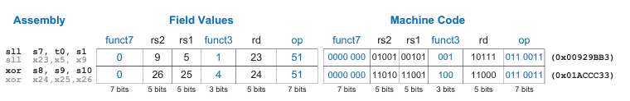
Figure 6.14 More machine code for R-type instructions

Slide 7
TRANSLATING R-TYPE ASSEMBLY INSTRUCTIONS INTO MACHINE CODE
Translate the following RISC-V assembly instruction into machine language:
add t3, s4, s5

Slide 8
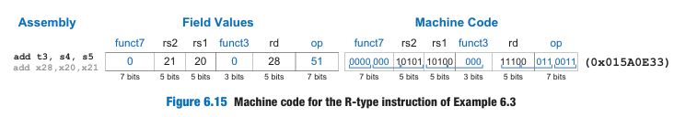
Solution::::
t3, s4, and s5 are registers 28, 20, and 21.
add has an opcode of 51 (0110011) and function codes of funct7 = 0 and funct3 = 0.
The easiest way to write the machine language in hexadecimal is to first write it in binary, then look at consecutive groups of four bits, which correspond to hexadecimal digits (indicated by blue underbars). Hence, the machine language instruction is 0x015A0E33.

Slide 9
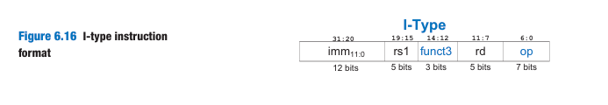
l-Type Instructions
I-type (immediate) instructions use two register operands and one immediate operand.
I-type instructions include addi, andi, ori, and xori, loads (lw, lh, lb, lhu, and lbu), and register jumps (jalr).
It is similar to R-type but includes a 12-bit immediate field imm instead of the funct7 and rs2 fields. rs1 and imm are the source operands, and rd is the destination register

Slide 10
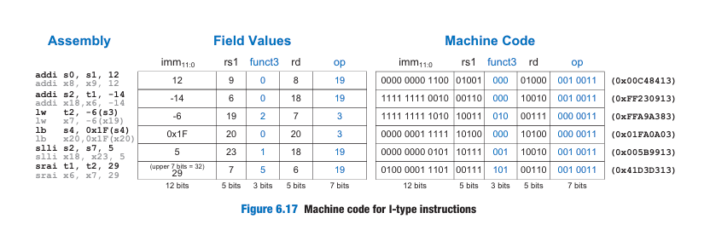

Slide 11
TRANSLATING I-TYPE ASSEMBLY INSTRUCTIONS INTO MACHINE CODE
Translate the following assembly instruction into machine language. lw t3, −36(s4)

Slide 12
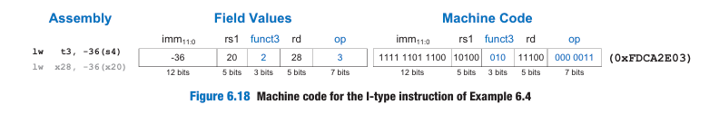
Solution:::
t3, and s4 are registers 28 and 20. rs1 (s4 = x20) specifies the base address, and rd (t3 = x28) specifies the destination.
The immediate, imm, encodes the 12-bit offset (−36)
lw has an op of 3 (0000011) and funct3 of 2 (010).

Slide 13
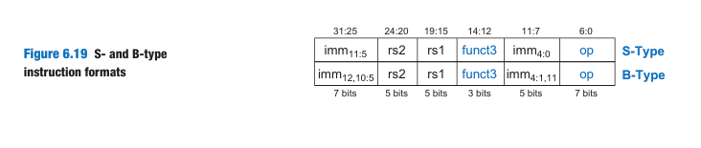
S/B-Type Instructions
S/B-type (store/branch) instructions use two register operands and one immediate operand.
However, both of the register operands are source registers (rs1 and rs2) in S/B-type, whereas I-type instructions use one source register (rs1) and one destination register (rd).

Slide 14
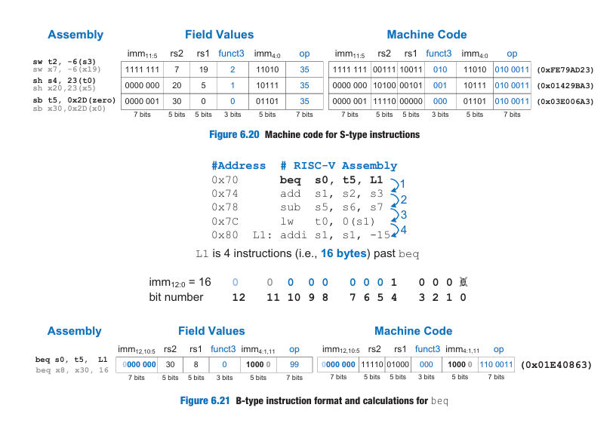

Slide 15
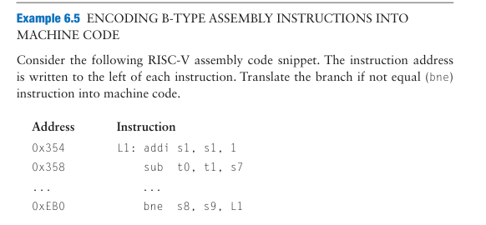

Slide 16
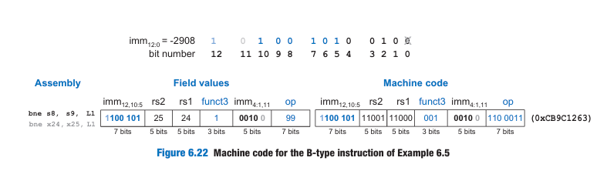
Solution:::
s8 and s9 are registers 24 and 25.
So, rs1 is 24 and rs2 is 25. The label L1 is 0xEB0 − 0x354 = 0xB5C (2908) bytes before the bne instruction.
So, the 13-bit immediate is −2908 (1010010100100).
op is 99 (1100011) and funct3 is 1 (001)

Slide 17
U/J-type instructions
U/J-type (upper immediate/jump) instructions have one destination register operand rd and a 20-bit immediate field
Like other formats, U/J-type instructions have a 7-bit opcode.
In U-type instructions, the remaining bits specify the most significant 20 bits of a 32-bit immediate.
In J-type instructions, the remaining 20 bits specify the most significant 20 bits of a 21-bit immediate jump offset.
As with B-type instructions, the least significant bit of the immediate is always 0 and is not encoded in the J-type instruction.

Slide 18
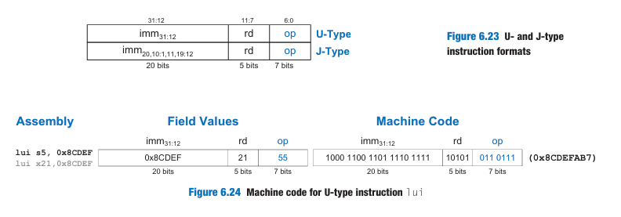

Slide 19
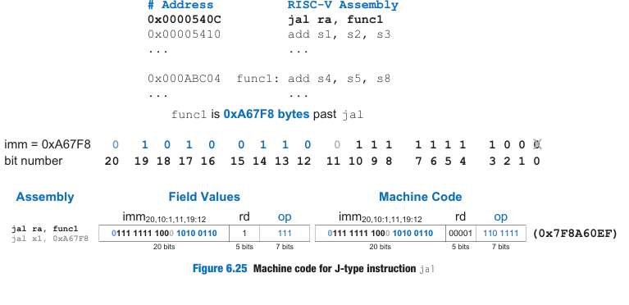

Slide 20
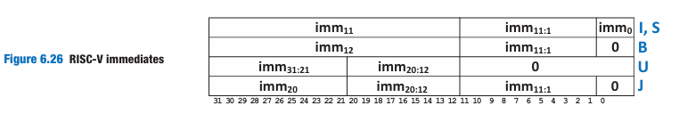
Immediate Encodings
RISC-V uses 32-bit signed immediates.
Only 12 to 21 bits of the immediate are encoded in the instruction.
I- and S-type instructions encode 12-bit signed immediates.
J- and B-type instructions use 21- and 13-bit signed immediates, where the least significant bit is always 0

Slide 21
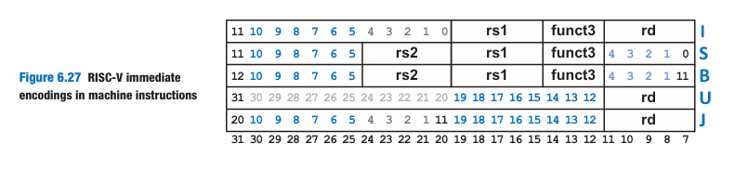

Slide 22
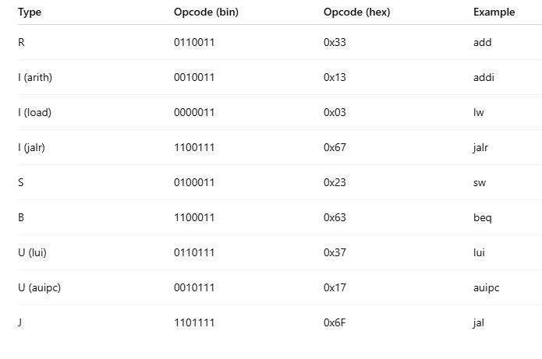
OPCODE::

Slide 23
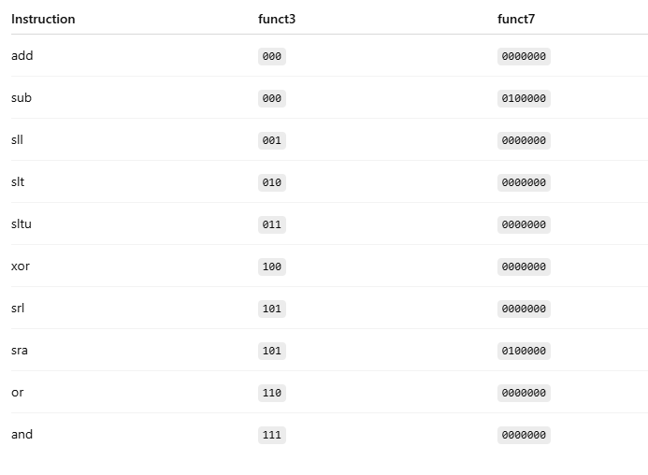
R-Type ALU Instructions
OPCODE: 0110011

Slide 24
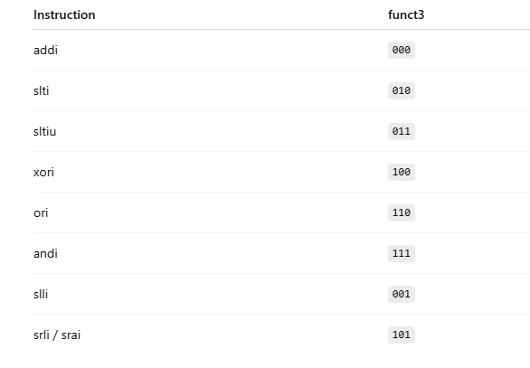
Immediate ALU OPCODE: 0010011

Slide 25
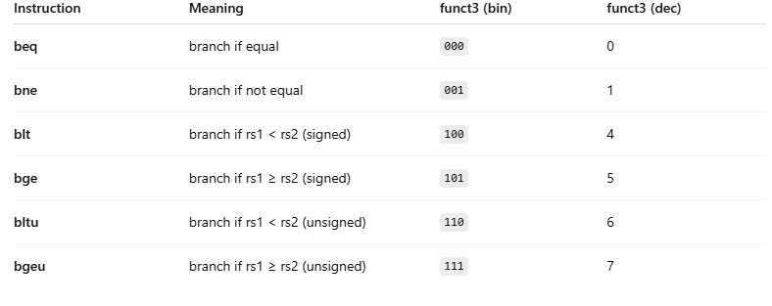
B-type::
1100011 (decimal 99)

Slide 26
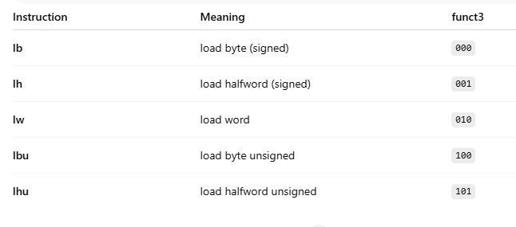
Load Instructions (I-Type)
OPCODE:: 0000011

Slide 27
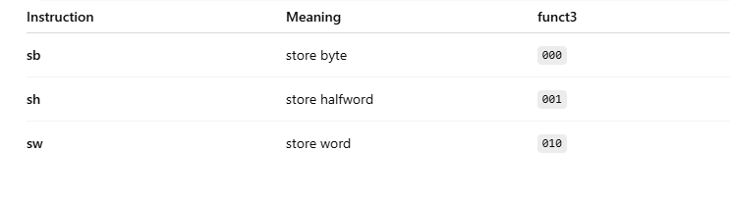
Store Instructions (S-Type)
OPCODE: 0100011

Slide 28
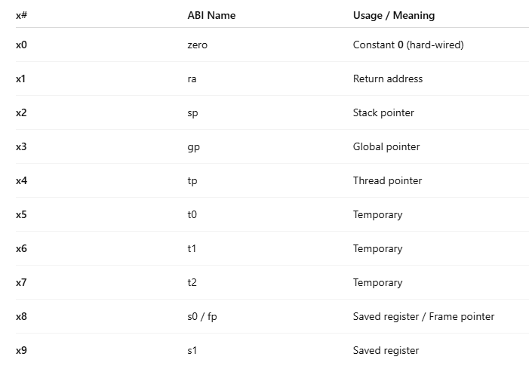
RISC-V Integer Registers (x0 – x31)

Slide 29
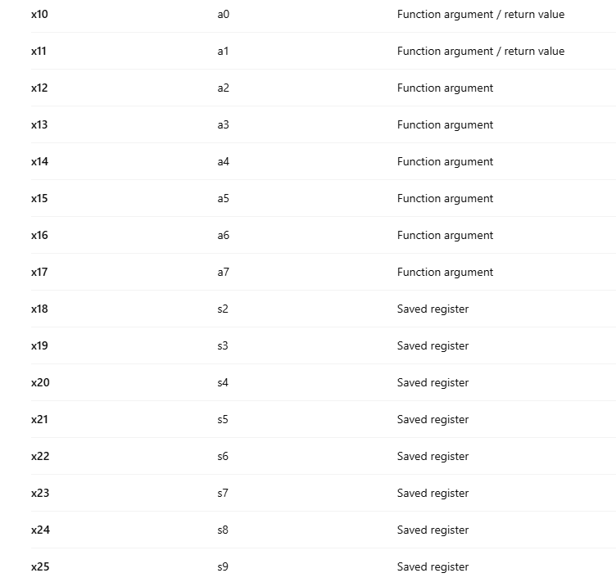

Slide 30
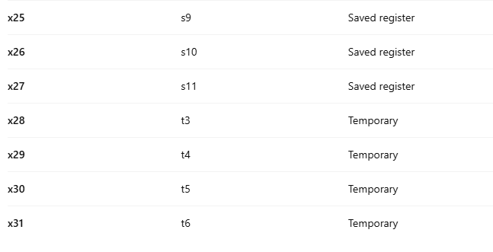

Slide 31
Addressing Modes
An addressing mode defines how an instruction specifies its operands. This section summarizes the modes used for addressing instruction operands.
RISC-V uses four main modes: register, immediate, base, and PC-relative addressing.
Most other architectures provide similar addressing modes, so understanding these modes helps you learn other assembly languages.
The first three modes (register, immediate, and base addressing) define modes of reading and writing operands.
The last mode (PC-relative addressing) defines a mode of writing the program counter (PC).

Slide 32
Register-Only Addressing
Register-only addressing uses registers for all source and destination operands.
All R-type instructions use register-only addressing.

Slide 33
Immediate Addressing
Immediate addressing uses an immediate, along with registers, as operands.
Some I-type instructions, such as add immediate (addi) and xori, use immediate addressing with a 12-bit signed immediate.
Shift instructions with an immediate shift amount (slli, srli, and srai) are I-type instructions that encode the 5-bit unsigned immediate shift amount in imm4:0.
Load instructions (lb, lh, and lw) use the I-type instruction format but use base addressing, which is discussed next.

Slide 34
Base Addressing
Memory access instructions, such as load word (lw) and store word (sw), use base addressing.
The effective address of the memory oper and is calculated by adding the base address in register rs1 to the sign- extended 12-bit offset found in the immediate field.
Loads are I-type instructions and stores are S-type instructions.

Slide 35
PC-Relative Addressing
Branch and jump and link (jal) instructions use PC-relative addressing to specify the new value of the PC.
The signed offset encoded in the immediate field is added to the PC to obtain the target address, the new PC; hence, the target address is said to be relative to the current PC.
Branches and jal use a 13- and 21-bit signed immediate, respectively, or the offset.
The most significant bits of the offset are encoded in the 12- and 20-bit immediate fields of the B- and J-type instructions.
The offset’s least significant bit is always 0, so it is not encoded in the instruction.
The auipc (add upper immediate to PC) instruction also uses PC-relative addressing. For example, the instruction auipc s3, 0xABCDE places PC + 0xABCDE000 in s3.

Slide 36
Interpreting Machine Language Code
To interpret machine language, one must decipher the fields of each 32-bit instruction word.
Different instructions use different formats, but all formats share a 7-bit opcode field.
Thus, the best place to begin is to look at the opcode to determine if it is an R-, I-, S/B-, or U/J-type instruction.

Slide 37
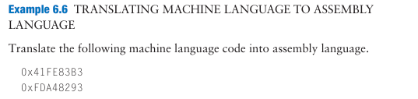
TRANSLATING MACHINE LANGUAGE TO ASSEMBLY LANGUAGE

Slide 38
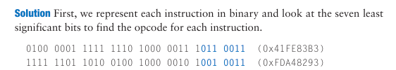
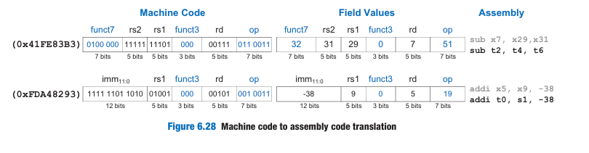
Solution:::
The opcode determines how to interpret the rest of the bits.
The first instruction’s opcode is 0110011.
It is an R-type instruction and we can divide the rest of the bits into the R-type fields.
The second instruction’s opcode is 0010011 , which means it is an I-type instruction

Slide 39
The Power of the Stored Program
A program written in machine language is a series of 32-bit numbers representing the instructions.
Like other binary numbers, these instructions can be stored in memory. This is called the stored program concept, and it is a key reason why computers are so powerful.
Instructions in a stored program are retrieved, or fetched, from memory and executed by the processor.
Even large, complex programs are simply a series of memory accesses and instruction executions

Slide 40
To run or execute the stored program, the processor fetches the instructions from memory sequentially.
The fetched instructions are then decoded and executed by the digital hardware.
The address of the current instruction is kept in the 32-bit program counter (PC) register.

Slide 41
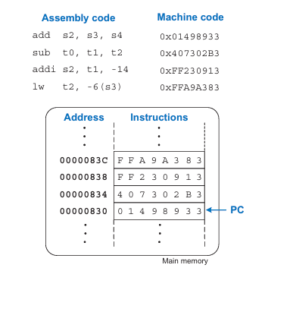
To execute the code, the PC is initialized to address 0x00000830.
The processor fetches the instruction at that memory address and executes the instruction, 0x01498933 (add s2, s3, s4).
The processor then increments the PC by 4 to 0x00000834, fetches and executes that instruction, and repeats.
Figure 6.29 Stored program

Slide 42
The architectural state of a microprocessor holds everything necessary to determine what a program will do.
For RISC-V, the architectural state includes the memory, register file, and PC.
If the operating system (OS) saves the architectural state at some point in the program, it can interrupt the program, do something else, and then restore the state such that the program continues properly, unaware that it was ever interrupted.

Slide 43
EVOLUTION OF THE RISC-V ARCHITECTURE
RISC-V was designed to be a commercially viable, open-source computer architecture, that is robust, efficient, and flexible.
RISC-V differentiates itself from other architectures because
it is open source,
uses base instruction sets to ease compatibility,
supports the full range of micro architectures,
from embedded systems to high-performance computers,
offers both defined and customizable extensions,
and provides features, such as compressed instructions and RV128I, that optimize hardware and support both existing and future designs, ensuring the architecture’s longevity.

Slide 44
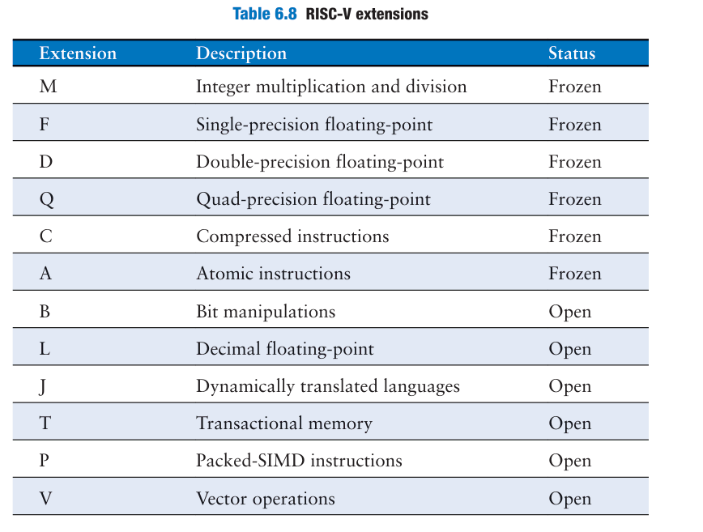

Slide 45
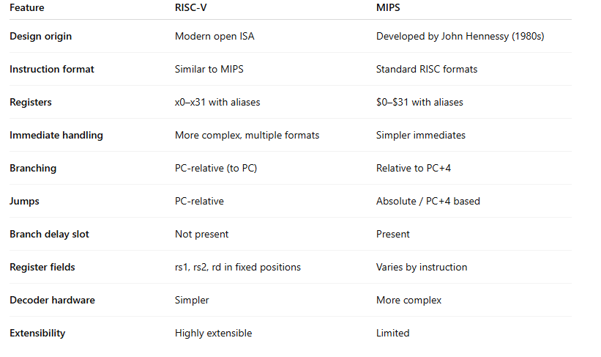

Slide 46
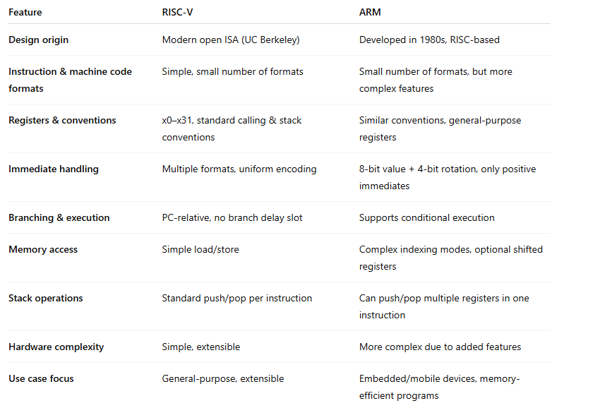

Slide 47
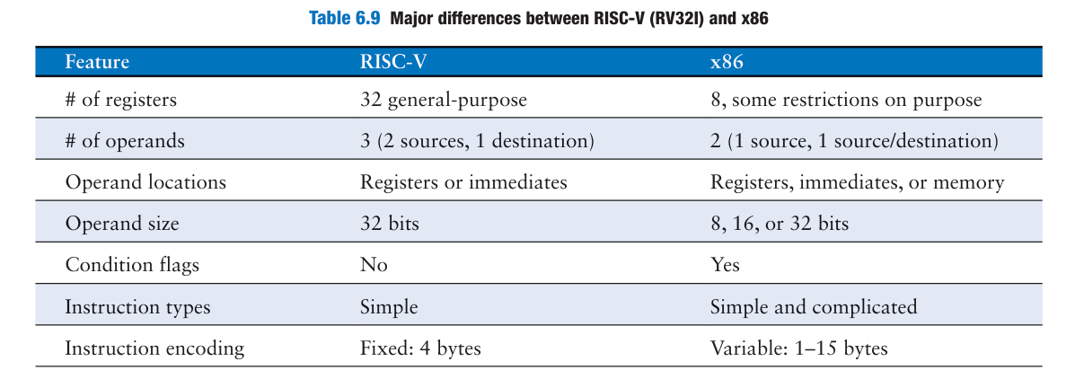

Slide 48
